Slide 1
Artificial Intelligence Task 1 : Informed Search
A* Search

Slide 2
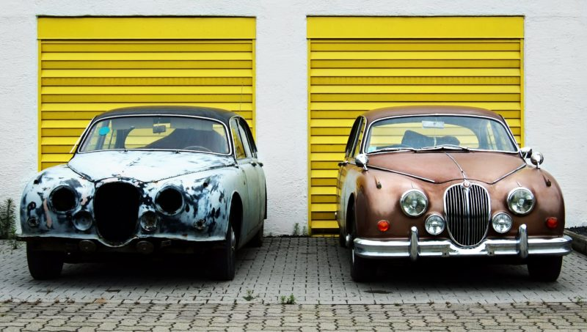
Developing intuition
Which one is an old car?

Slide 3


Developing intuition
Which one is a malware?

Slide 4
Naïve BFS
1
End
Start
2
3

Slide 5
Naïve BFS
1
End
Start
2
3

Slide 6
Naïve BFS
1
End
Start
2
3

Slide 7
Naïve BFS
1
End
Start
2
3

Slide 8
Naïve BFS
1
End
Start
2
3

Slide 9
Heuristic
1
End
h_score()
Start
2
3

Slide 10
Heuristic
h_score()
1
End
h_score()
Start
2
3

Slide 11
Heuristic
h_score()
1
End
g_score()
h_score()
Start
g_score()
2
3

Slide 12
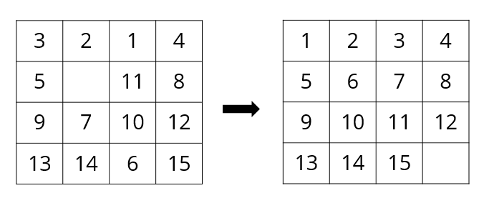
N-puzzle

Slide 13
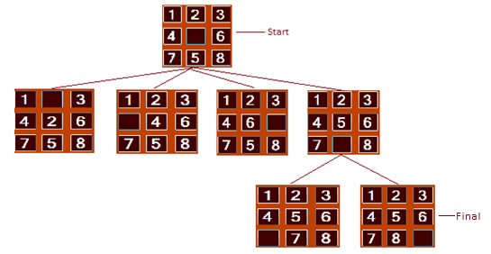
N-puzzle

Slide 14
N-puzzle

Slide 15
N-puzzle

Slide 16
What should be the heuristic?

Slide 17
Two properties of a heuristics function
- Admissible (Optimistic)
- Consistent

Slide 18
Applying A* Algorithm

Slide 19
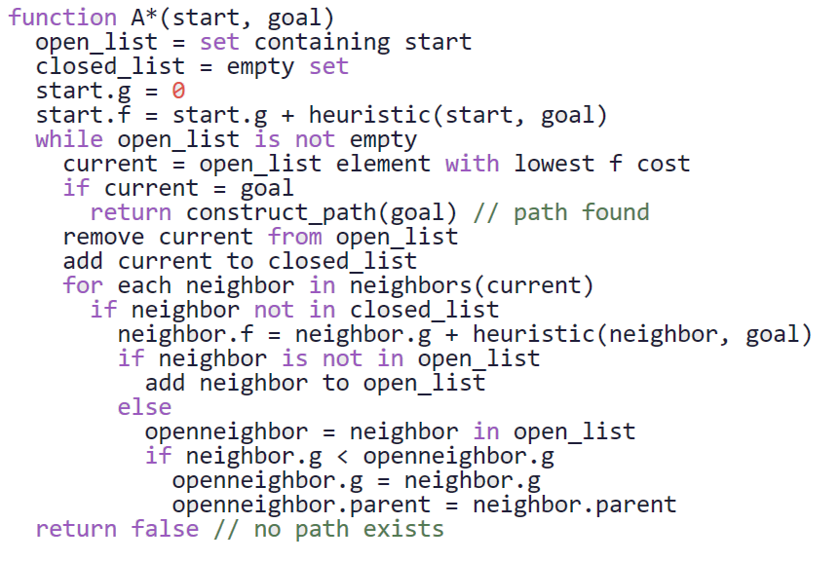
Applying A* Algorithm

Slide 20
Applying A* Algorithm

Slide 21
Applying A* Algorithm

Slide 22
Applying A* Algorithm

Slide 23
Applying A* Algorithm

Slide 24
Applying A* Algorithm

Slide 25
Applying A* Algorithm

Slide 26
Applying A* Algorithm

Slide 27
Applying A* Algorithm

Slide 28
Applying A* Algorithm

Slide 29
Applying A* Algorithm
1
End
Start
h_score()
2
3

Slide 30
Applying A* Algorithm
1
End
Start
h_score()
2
3

Slide 31
Applying A* Algorithm
1
End
Start
h_score()
2
3

Slide 32
Applying A* Algorithm
1
End
Start
h_score()
2
3

